Slide 1

E-AUCTION APPLICATION FOR DREAM 11
NAME:K.RAKESH
REG NO:192011120
CSA3724
SOFTWARE TESTING FOR DEBUGGING
DR.GURURAMA SENTHIL P

Slide 2
AIM
TO ANALYSE E-AUCTION APPLICATION FOR DREAM11 WORKING PROPERLY OR NOT.

Slide 3
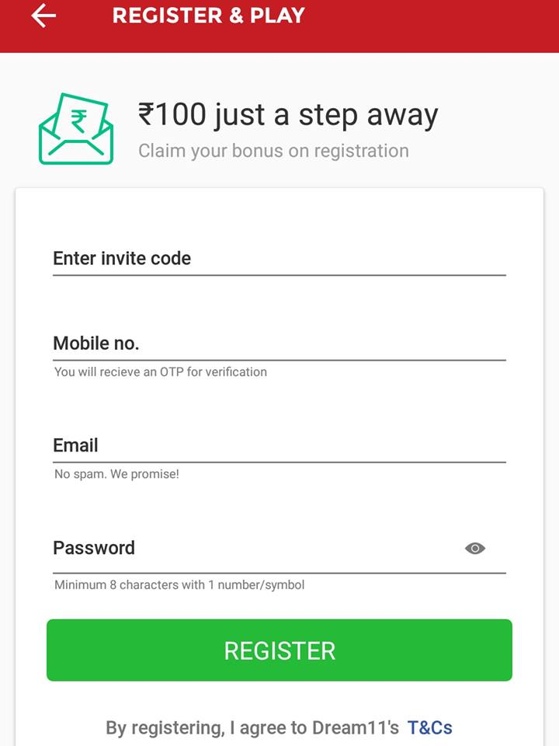
REQUIREMENTS
LOGIN MODULE
PAYMENT MODULE
USER NAME
PASSWORD
WEBSITE (WWW.DREAM11.COM)

Slide 4
TEST SCENARIO login using Account info
Step-1: Go to the e-auction payment portal homepage and click Login.
Step-2: Enter your USERNAME & PASSWORD and click Continue.
Step-3:Select OTP on mobile registered with Account after confirming your Secure
Access Message and click Continue. In case of using Account OTP as a higher security
option, login with your user ID and password and on the Higher Security Options page,
click OTP on mobile number registered with Account> Continue.
Step-4: If you already have OTP, select I already have OTP on mobile number registered
with Account and go to Step 6. If valid OTP is not available, click Generate OTP.
Step-5: On the Verify, it's you page, click I Agree to validate my Account Details > Generate Account OTP.
Step-6: Enter your 6-digit OTP received on your mobile number registered with Account and click Login.
Post successful validation, you will be taken to the e-auction payment Dashboard.

Slide 5
TEST SCENARIO (REGISTERING AN ACCOUNT)
STEP-1: Visit the ‘e-Auction payment’ Portal https://www.dream11.in/portal/
STEP-2: Click ‘Register Yourself' button located at right side of the Home Page
STEP-3:Select the user type as ‘Individual’. Click Continue
STEP-4:Provide the following basic details:
Account number &Pan card number
Surname, First Name and Middle Name
Date of birth
Residential Status and click continue
STEP-5: Fill in the following mandatory details:
Password Details
Contact Details
Current Address
Click ‘Submit’.
STEP-6: After registration,
*For Residents, a six digit OTP1 and OTP2 will be shared on your mobile number and email ID, specified at the time of registration. *For Non-residents, OTP will be shared on your primary email ID, specified at the time of registration.
STEP-7: Enter the correct OTP to complete the registration process

Slide 6
LOGIN TEST CASES
POSITIVE TEST CASES
Enter Valid email or mobile number.
Enter Valid Password.
Click on “Forgot Password” Link and find out forgot password page.
Click on Create new account button and verify if it takes to new account page.
Select “Keep me signed in” option to retain login session
Select “Help” option to get help from DREAM11.
Select “Privacy Note” to get DREAM11 privacy polices page.
In Forgot page –Enter the OTP(One Time Password) to recreate the DREAM11 password.
Clicking on the “product image” .It directly takes to the product page.
Clicking on the “Buy Now “ link Button. It directly takes to the payment page.

Slide 7
NEGATIVE TEST CASES
Enter invalid username and valid password.
Enter valid username and invalid password.
Enter invalid username and password.
Keep one field blank either username or password and check login.
The price on the image and the on the product was mostly different.
The payment declaim was high in the DREAM11 pages.
Need to improve the return and replacement options.
Need to improve the UI(USER INTERFACE) on the web site.
When the network was slow the was buffer on that time.
On searching one product It shows different products

Slide 8
PAYMENT TEST CASES
POSITIVE / PASS
NEGATIVE / FAIL
To verify register option is available.
To verify account number with registered mobile number.
To verify user should validate and continue with valid PAN card number.
To verify with OTP registered mobile number.
To verify all fields must be filled.
To verify all user basic details must be as per PAN card.
To verify account is secured.
To verify register option is not working.
To be verify without OTP.
To verify user can’t login or validate with invalid PAN card number.
To verify all field or any one is empty.
To verify user not entering last name and basic details as per PAN in basic section.
To verify account is not secured.

Slide 9
CONCLUSION
I have navigate the DREAM11 web application and find out the positive / pass and negative / fail test cases. This is to improve the application performance in better manner.

Slide 10
THANK YOU

